Slide 1
Content Realization
Ling573
Systems and Applications
May 14, 2020

Slide 2
Roadmap
Content realization
Linguistic quality
Improving referring expressions
Compression approaches
Heuristic techniques
Linguistically motivated methods
Learning compression

Slide 3
Content Realization: Referring Expressions

Slide 4
Referring to People in News Summaries
Intuition:
Referring expressions common source of errors
References to people prevalent in news data, summaries
Information status constrains realization
Targeted rewriting can improve readability

Slide 5
Referring to People in News Summaries
Intuition: (Nenkova, ‘08; Siddarthan et al, 2011)
Referring expressions common source of errors
References to people prevalent in news data, summaries
Information status constrains realization
Targeted rewriting can improve readability
Approach:
Exploit information status distinctions
Automatically identified
Use to guide rule-based generation of referring expressions

Slide 6
Challenges

Slide 7
Challenges
Lack of training data:
No summary data labeled for information status
Readers sensitive to referring expressions
Prior work on NP rewriting has shown mixed results
Some improvement, some failures
Relies on potentially errorful coref, other processing

Slide 8
NP Rewrite: very good example
While the British government defended the arrest, it took no stand on extradition of Pinochet to Spain, leaving it to the courts.
While the British government defended the arrest in London of former Chilean dictator Augusto Pinochet, it took no stand on extradition of Pinochet to Spain, leaving it to British courts.

Slide 9
NP Rewrite: mixed example
Duisenberg has said growth in the euro area countries next year will be about 2.5 percent, lower than the 3 percent predicted earlier.
Wim Duisenberg, the head of the new European Central Bank, has said growth in the euro area countries next year will be about 2.5 percent, lower than just 1 percent in the euro-zone unemployment predicted earlier.

Slide 10
Information Status
Build on three key distinctions:
Discourse-new vs discourse-old:
First mention handling vs others
Hearer-new vs hearer-old:
Distinguish well-known individuals from others
Don’t waste space describing well-known individuals
Major vs minor character:
Salience of the person in the event

Slide 11
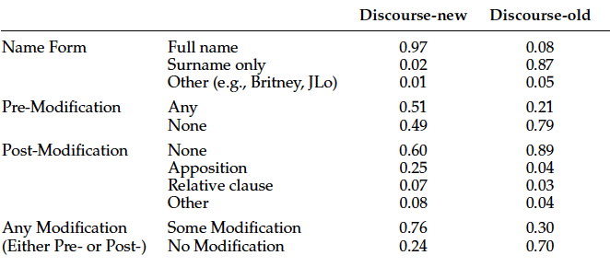
Corpus Analysis
Assess relation between:
information status and referring expressions
Siddharthan et al, 2011, p. 818, Table 1

Slide 12
Generating Discourse-New/Old
If discourse-new,
If the NP head is a person name,
If appears with pre-modifier in text, write as:
Longest pre-modifier + full name
Else if it appears with an apposition modifier
Add that to the reference
Else don’t rewrite
Else use surname only

Slide 13
Generating Discourse-New/Old
If discourse-new,
If the NP head is a person name,
If appears with pre-modifier in text, write as:
Longest pre-modifier + full name
Else if it appears with an apposition modifier
Add that to the reference
Else don’t rewrite
Else use surname only
Significantly preferred over original forms

Slide 14
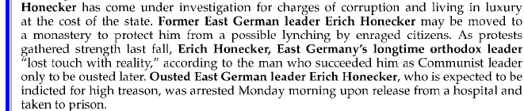
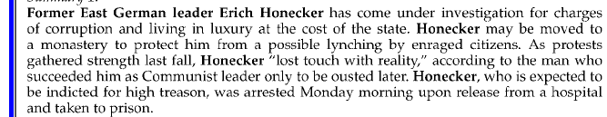
Example Rewrite
Siddharthan et al, 2011, p. 818, Table 1

Slide 15
Hearer & Salience
Discourse-new status:

Slide 16
Hearer & Salience
Discourse-new status:
Obvious from summary
How do we establish hearer or major/minor status?

Slide 17
Hearer & Salience
Discourse-new status:
Obvious from summary
How do we establish hearer or major/minor status?
Categorize based on human summaries (gold)
Specifically by their referring expressions:
Hearer-old (i.e. familiar)
Title/role+surname or unmodified fullname
Major:
Referred to by name in some human summary of topic
258 major/3926 minor by data

Slide 18
Training & Application
Trained classifiers to recognize – using features in docset
H-New/Old: F-measure: 0.75 on both classes
Major/Minor: F: Major: 0.6; Minor: 0.98
All significantly better than baseline

Slide 19
Training & Application
Trained classifiers to recognize – using features in docset
H-New/Old: F-measure: 0.75 on both classes
Major/Minor: F: Major: 0.6; Minor: 0.98
All significantly better than baseline
Create rules based on classification to:
Use names (only) for major characters (o.w. common)
Exclude post-modifiers for hearer-old, tune for new
Include titles for initial mentions
Include affiliation premodifiers based on hearer/salience

Slide 20
Evaluation
Created (nearly) deterministic rule set
Based on information status classification
To rewrite referring expressions in extractive summaries
Evaluated in paired preference tests over:
Original Extractive and Rewritten Summaries
Where a preference was expressed,
Rewritten summaries rated as more coherent
Extractive rated as more informative

Slide 21
Evaluation
Created (nearly) deterministic rule set
Based on information status classification
To rewrite referring expressions in extractive summaries
Evaluated in paired preference tests over:
Original Extractive and Rewritten Summaries
Where a preference was expressed,
Rewritten summaries rated as more coherent
Extractive rated as more informative
Why? Rewrite rules generally shrink rather than add content

Slide 22
Sentence Compression

Slide 23
Sentence Compression
Main strategies:
Heuristic approaches
Deep vs Shallow processing
Information- vs readability- oriented
Machine-learning approaches
Sequence models
HMM, CRF, LSTM
Deep vs Shallow information
Integration with selection
Pre/post-processing; Candidate selection: heuristic/learned

Slide 24
Form | CLASSY | ICSI | UMd | SumBasic+ | Cornell
Initial Adverbials | Y | M | Y | Y | Y
Initial Conj | Y |  | Y | Y
Gerund Phr. | Y | M | M | Y | M
Rel clause appos | Y |  | M | Y | Y
Other adv | Y
Numeric: ages, | Y
Junk (byline, edit) | Y |  |  |  | Y
Attributives | Y | Y |  | Y | Y
Manner modifiers | M | Y | M |  | Y
Temporal modifiers | M | Y | Y |  | Y
POS: det, that, MD |  |  | Y
XP over XP |  |  | Y
PPs (w/, w/o constraint) |  |  | Y
Preposed Adjuncts |  |  | Y
SBARs |  |  | Y |  | M
Conjuncts |  |  | Y
Content in parentheses |  | Y |  |  | Y

Slide 25
Shallow, Heuristic
CLASSY 2006
Pre-processing! Improved ROUGE
Previously used automatic POS tag patterns: error-prone
Lexical & punctuation surface-form patterns
“function” word lists: Prep, conj, det; adv, gerund; punct
Removes:
Junk: bylines, editorial
Sentence-initial adverbials, conj phrase (up to comma)
Sentence medial adverbials (“also”), ages
Gerund (-ing) phrases
Rel. clause attributives, attributions w/o quotes
Conservative: < 3% error (vs 25% w/POS)

Slide 26
Deep, Minimal, Heuristic
ICSI/UTD:
Use an Integer Linear Programming approach to solve
Trimming:
Goal: Readability (not info squeezing)
Removes temporal expressions, manner modifiers, “said”
Why?:

Slide 27
Deep, Minimal, Heuristic
ICSI/UTD:
Use an Integer Linear Programming approach to solve
Trimming:
Goal: Readability (not info squeezing)
Removes temporal expressions, manner modifiers, “said”
Why?: “next Thursday”
Methodology: Automatic SRL labeling over dependencies
SRL not perfect: How can we handle?

Slide 28
Deep, Minimal, Heuristic
ICSI/UTD:
Use an Integer Linear Programming approach to solve
Trimming:
Goal: Readability (not info squeezing)
Removes temporal expressions, manner modifiers, “said”
Why?: “next Thursday”
Methodology: Automatic SRL labeling over dependencies
SRL not perfect: How can we handle?
Restrict to high-confidence labels
Improved ROUGE on (some) training data
Also improved linguistic quality scores

Slide 29
Example
A ban against bistros
providing plastic bags
free of charge will be
lifted at the beginning
of March.

Slide 30
Example
A ban against bistros
providing plastic bags
free of charge will be
lifted at the beginning
of March.
A ban against bistros
providing plastic bags
free of charge will be
lifted.

Slide 31
Deep, Extensive, Heuristic
Both UMD & SumBasic+
Based on output of phrase structure parse

Slide 32
Deep, Extensive, Heuristic
Both UMD & SumBasic+
Based on output of phrase structure parse
UMD: Originally designed for headline generation
Goal: Information squeezing, compress to add content

Slide 33
Deep, Extensive, Heuristic
Both UMD & SumBasic+
Based on output of phrase structure parse
UMD: Originally designed for headline generation
Goal: Information squeezing, compress to add content
Approach: (UMd)
Ordered cascade of increasingly aggressive rules
Subsumes many earlier compressions

Slide 34
Deep, Extensive, Heuristic
Both UMD & SumBasic+
Based on output of phrase structure parse
UMD: Originally designed for headline generation
Goal: Information squeezing, compress to add content
Approach: (UMd)
Ordered cascade of increasingly aggressive rules
Subsumes many earlier compressions
Adds headline oriented rules (e.g. removing MD, DT)

Slide 35
Deep, Extensive, Heuristic
Both UMD & SumBasic+
Based on output of phrase structure parse
UMD: Originally designed for headline generation
Goal: Information squeezing, compress to add content
Approach: (UMd)
Ordered cascade of increasingly aggressive rules
Subsumes many earlier compressions
Adds headline oriented rules (e.g. removing MD, DT)
Adds rules to drop large portions of structure
E.g. halves of AND/OR, wholesale SBAR/PP deletion

Slide 36
Integrating Compression & Selection
Simplest strategy: (Classy, SumBasic+)

Slide 37
Integrating Compression & Selection
Simplest strategy: (Classy, SumBasic+)
Deterministic, compressed sentence replaces original
Multi-candidate approaches: (most others)

Slide 38
Integrating Compression & Selection
Simplest strategy: (Classy, SumBasic+)
Deterministic, compressed sentence replaces original
Multi-candidate approaches: (most others)
Generate sentences at multiple levels of compression

Slide 39
Integrating Compression & Selection
Simplest strategy: (Classy, SumBasic+)
Deterministic, compressed sentence replaces original
Multi-candidate approaches: (most others)
Generate sentences at multiple levels of compression
Possibly constrained by: compression ratio, minimum len
E.g. exclude: < 50% original, < 5 words (ICSI)

Slide 40
Integrating Compression & Selection
Simplest strategy: (Classy, SumBasic+)
Deterministic, compressed sentence replaces original
Multi-candidate approaches: (most others)
Generate sentences at multiple levels of compression
Possibly constrained by: compression ratio, minimum len
E.g. exclude: < 50% original, < 5 words (ICSI)
Add to original candidate sentences list
Select based on overall content selection procedure
Possibly include source sentence information

Slide 41
Integrating Compression & Selection
Simplest strategy: (Classy, SumBasic+)
Deterministic, compressed sentence replaces original
Multi-candidate approaches: (most others)
Generate sentences at multiple levels of compression
Possibly constrained by: compression ratio, minimum len
E.g. exclude: < 50% original, < 5 words (ICSI)
Add to original candidate sentences list
Select based on overall content selection procedure
Possibly include source sentence information
E.g. only include single candidate per original sentence

Slide 42
Multi-Candidate Selection
(UMd, Zajic et al. 2007, etc)
Sentences selected by tuned weighted sum of feats

Slide 43
Multi-Candidate Selection
(UMd, Zajic et al. 2007, etc)
Sentences selected by tuned weighted sum of feats
Static:
Position of sentence in document
Relevance of sentence/document to query
Centrality of sentence/document to topic cluster
Computed as: IDF overlap or (average) Lucene similarity

Slide 44
Multi-Candidate Selection
(UMd, Zajic et al. 2007, etc)
Sentences selected by tuned weighted sum of feats
Static:
Position of sentence in document
Relevance of sentence/document to query
Centrality of sentence/document to topic cluster
Computed as: IDF overlap or (average) Lucene similarity
# of compression rules applied

Slide 45
Multi-Candidate Selection
(UMd, Zajic et al. 2007, etc)
Sentences selected by tuned weighted sum of feats
Static:
Position of sentence in document
Relevance of sentence/document to query
Centrality of sentence/document to topic cluster
Computed as: IDF overlap or (average) Lucene similarity
# of compression rules applied
Dynamic:
Redundancy: S=Π_{wi} _{in} _{S} λP(w|D) + (1-λ)P(w|C)
# of sentences already taken from same document

Slide 46
Multi-Candidate Selection
(UMd, Zajic et al. 2007, etc)
Sentences selected by tuned weighted sum of feats
Static:
Position of sentence in document
Relevance of sentence/document to query
Centrality of sentence/document to topic cluster
Computed as: IDF overlap or (average) Lucene similarity
# of compression rules applied
Dynamic:
Redundancy: S=Π_{wi} _{in} _{S} λP(w|D) + (1-λ)P(w|C)
# of sentences already taken from same document
Significantly better on ROUGE-1 than uncompressed
Grammaticality lousy (tuned on headlinese)

Slide 47
Neural Network Methods
Sentence Compression by Deletion with LSTMs
Filippova et al, 2015
Formulation:
Label each word in input as 0/1:
Drop vs Keep
Model:
3 successive LSTM layers w/dropout to softmax pred
Comparisons:
Different representations

Slide 48
Input Representations
Basic LSTM:
256-dim word2vec skipgram + previous word label
Training: gold; Test: predicted
LSTM+par:
Add vector rep for parent in dependency parse
LSTM+par+pres:
Adds bits for parent node status:
seen+kept; seen+dropped; not-yet-seen

Slide 49
Training & Evaluation
Trained on 2M newswire sentence/compress pairs
All compressions only drop words
Automatic comparison:
F1: 80%+; ~5% absolute better than prior ML system
Each representation gains ~1% F1
Human eval on readability & informativeness
~4.5 on fluency; 3.7 on info
~0.2 better than prior

Slide 50
Examples
Chris Hemsworth and the crew of his new movie ‘In the Heart of the Sea’ were forced to flee flash floods in the Canary Islands yesterday.
Chris Hemsworth were forced to flee flash floods.
Just a week after a CISF trooper foiled a suicide bid by a woman in the Delhi metro, another woman trooper from the same force prevented two women commuters from ending their lives, an official said Monday.
Another woman trooper prevented two women commuters
Social activist Medha Patkar on Monday extended her “complete” support to Arvind Kejriwal-led Aam Aadmi Party in Maharashtra.
Medha Patkar extended her support to Aam Aadmi Party.
State Sen. Stewart Greenleaf discusses his proposed human trafficking bill at Calvery Baptist Church in Willow Grove Thursday night.
Stewart Greenleaf discusses his human trafficking bill.

Slide 51
Observations
What components were dropped?
Appositives – even long ones
Adverbial phrases
Attributives
Fairly similar to those in rule-based models
Issues?
More complex structure – e.g. conjuncts, restrictive vs non-restrictive relative clauses, etc
Mis-triggered punctuation

Slide 52
Learning Compression
Cornell (Wang et al, 2013)
Contrasted three main compression strategies
Rule-based
Sequence-based learning
Tree-based, learned models
Resulting sentences selected by SVR model

Slide 53
Compression Corpus
(Clark & Lapata, 2008)
Manually created corpus:
Written: 82 newswire articles (BNC, ANT)
Spoken: 50 stories from HUB-5 broadcast news

Slide 54
Compression Corpus
(Clark & Lapata, 2008)
Manually created corpus:
Written: 82 newswire articles (BNC, ANT)
Spoken: 50 stories from HUB-5 broadcast news
Annotators created compression sentence by sentence
Could mark as not compressable

Slide 55
Sequence-based Compression
View as sequence labeling problem

Slide 56
Sequence-based Compression
View as sequence labeling problem
Decision for each word in sentence: keep vs delete

Slide 57
Sequence-based Compression
View as sequence labeling problem
Decision for each word in sentence: keep vs delete
Model: linear-chain CRF
Labels: B-retain, I-retain, O (token to be removed)

Slide 58
Sequence-based Compression
View as sequence labeling problem
Decision for each word in sentence: keep vs delete
Model: linear-chain CRF
Labels: B-retain, I-retain, O (token to be removed)
Features:
“Basic” features: word-based
Rule-based features: if fire, force to O
Dependency tree features: Relations, depth
Syntactic tree features: POS, labels, head, chunk
Semantic features: predicate, SRL
Include features for neighbors

Slide 59
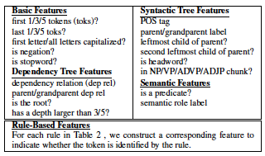
Feature Set
Detail:

Slide 60
Tree-based Compression
Given a phrase-structure parse tree,
Determine if each node is: removed, retained, or partial

Slide 61
Tree-based Compression
Given a phrase-structure parse tree,
Determine if each node is: removed, retained, or partial
Issues:
# possible compressions exponential

Slide 62
Tree-based Compression
Given a phrase-structure parse tree,
Determine if each node is: removed, retained, or partial
Issues:
# possible compressions exponential
Need some local way of scoring a node

Slide 63
Tree-based Compression
Given a phrase-structure parse tree,
Determine if each node is: removed, retained, or partial
Issues:
# possible compressions exponential
Need some local way of scoring a node
Need some way of ensuring consistency

Slide 64
Tree-based Compression
Given a phrase-structure parse tree,
Determine if each node is: removed, retained, or partial
Issues:
# possible compressions exponential
Need some local way of scoring a node
Need some way of ensuring consistency
Need to ensure grammaticality

Slide 65
Tree-based Compression
Given a phrase-structure parse tree,
Determine if each node is: removed, retained, or partial
Issues & Solutions:
# possible compressions exponential
Order parse tree nodes (here post-order)
Do beam search over candidate labelings

Slide 66
Tree-based Compression
Given a phrase-structure parse tree,
Determine if each node is: removed, retained, or partial
Issues & Solutions:
# possible compressions exponential
Order parse tree nodes (here post-order)
Do beam search over candidate labelings
Need some local way of scoring a node

Slide 67
Tree-based Compression
Given a phrase-structure parse tree,
Determine if each node is: removed, retained, or partial
Issues & Solutions:
# possible compressions exponential
Order parse tree nodes (here post-order)
Do beam search over candidate labelings
Need some local way of scoring a node
Use MaxEnt to compute probability of label
Need some way of ensuring consistency

Slide 68
Tree-based Compression
Given a phrase-structure parse tree,
Determine if each node is: removed, retained, or partial
Issues & Solutions:
# possible compressions exponential
Order parse tree nodes (here post-order)
Do beam search over candidate labelings
Need some local way of scoring a node
Use MaxEnt to compute probability of label
Need some way of ensuring consistency
Restrict candidate labels based on context
Need to ensure grammaticality

Slide 69
Tree-based Compression
Given a phrase-structure parse tree,
Determine if each node is: removed, retained, or partial
Issues & Solutions:
# possible compressions exponential
Order parse tree nodes (here post-order)
Do beam search over candidate labelings
Need some local way of scoring a node
Use MaxEnt to compute probability of label
Need some way of ensuring consistency
Restrict candidate labels based on context
Need to ensure grammaticality
Rerank resulting sentences using n-gram LM

Slide 70
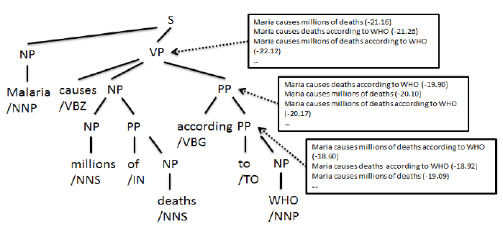
Tree Compression Hypotheses

Slide 71
Features
Basic features:
Analogous to those for sequence labeling

Slide 72
Features
Basic features:
Analogous to those for sequence labeling
Enhancements:
Context features: decisions about child, sibling nodes

Slide 73
Features
Basic features:
Analogous to those for sequence labeling
Enhancements:
Context features: decisions about child, sibling nodes
Head-driven search:
Reorder so head nodes at each level checked first
Why?

Slide 74
Features
Basic features:
Analogous to those for sequence labeling
Enhancements:
Context features: decisions about child, sibling nodes
Head-driven search:
Reorder so head nodes at each level checked first
Why? If head is dropped, shouldn’t keep rest
Revise context features

Slide 75
Summarization Features
(aka MULTI in paper)
Calculated based on current decoded word sequence W
Linear combination of:

Slide 76
Summarization Features
(aka MULTI in paper)
Calculated based on current decoded word sequence W
Linear combination of:
Score under MaxEnt
Query relevance:
Proportion of overlapping words with query
Importance: Average sumbasic score over W
Language model probability
Redundancy: 1 --- proportion of words overlapping summ

Slide 77
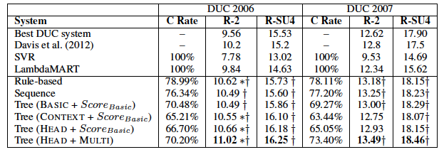
Summarization Results

Slide 78
Discussion
Best system incorporates:
Tree structure
Machine learning
Summarization features

Slide 79
Discussion
Best system incorporates:
Tree structure
Machine learning
Summarization features
Rule-based approach surprisingly competitive
Though less aggressive in terms of compression

Slide 80
Discussion
Best system incorporates:
Tree structure
Machine learning
Summarization features
Rule-based approach surprisingly competitive
Though less aggressive in terms of compression
Learning based approaches enabled by sentence compression corpus

Slide 81
General Discussion
Broad range of approaches:
Informed by similar linguistic constraints
Implemented in different ways:

Slide 82
General Discussion
Broad range of approaches:
Informed by similar linguistic constraints
Implemented in different ways:
Heuristic vs Learned
Surface patterns vs parse trees vs SRL
Even with linguistic constraints
Often negatively impact linguistic quality

Slide 83
General Discussion
Broad range of approaches:
Informed by similar linguistic constraints
Implemented in different ways:
Heuristic vs Learned
Surface patterns vs parse trees vs SRL
Even with linguistic constraints
Often negatively impact linguistic quality
Key issue: errors in linguistic analysis
POS taggers → Parsers → SRL, etc

Slide 84
D3
Code/results due Sunday
Tag as D3
Report due Tuesday morning
Tag as D3.1
Presentations next week
Please respond to scheduling Doodle

Slide 85
Deliverable #4
Final system
Continue system improvement
Add content realization
Evaluation:
Devtest (2010)
Evaltest (2011)
New blind test
New document set: Documents from Gigaword
New evaluation models, ROUGE config file

